Slide 1
Machine Learning
Topic Modeling

Slide 2
Making sense of text
Suppose you want to learn something about a corpus that’s too big to read
need to make sense of…
half a billion tweets daily
80,000 active NIH grants
hundreds of bills each year
Wikipedia (it’s big)
What topics are trending today on Twitter?
What research topics receive grant funding (and from whom)?
What issues are considered by Congress (and which politicians are interested in which topic)?
Are certain topics discussed more in certain languages on Wikipedia?

Slide 3
Making sense of text
Suppose you want to learn something about a corpus that’s too big to read
need to make sense of…
half a billion tweets daily
80,000 active NIH grants
hundreds of bills each year
Wikipedia (it’s big)
Feed documents into a computer algorithm and see what interesting patterns it finds?

Slide 4
Topic Models
Topic models can help you automatically discover patterns in a corpus
unsupervised learning
Topic models automatically…
group topically-related words in “topics”
associate tokens and documents with those topics
Topic modeling provides methods for automatically organizing, understanding, searching, and summarizing large electronic archives.
1 Discover the hidden themes that pervade the collection.
2 Annotate the documents according to those themes.
3 Use annotations to organize, summarize, and search the texts.

Slide 5
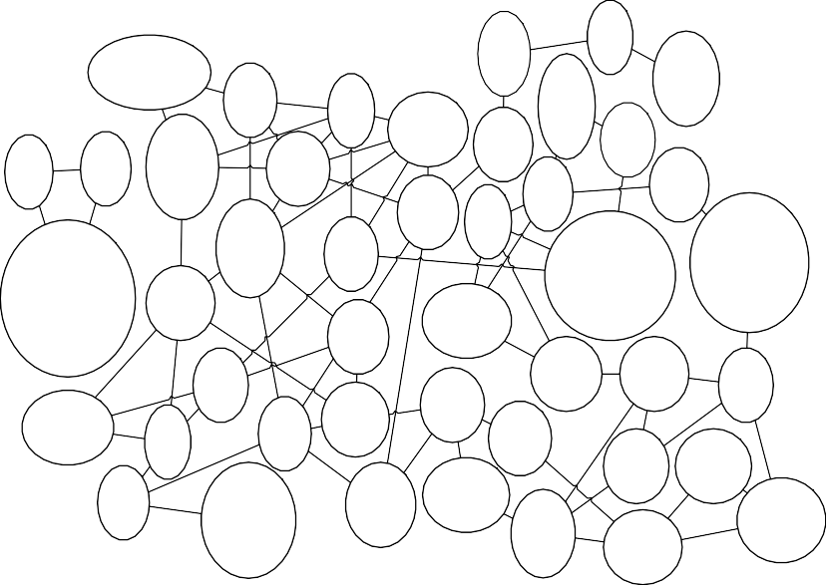
Model connections between topics
brain memory subjects left
task
neurons stimulus motor visual cortical
activated tyrosine phosphorylation
activation phosphorylation kinase
synapses ltp glutamate synaptic neurons
p53 cell cycle activity
cyclin regulation
surface tip image sample device
proteins protein binding domain domains
rna dna
rna polymerase cleavage
site
materials organic polymer polymers
^{molecules} physicists
particles physics particle experiment
receptor receptors ligand ligands apoptosis
computer problem information computers problems
research funding support nih program
science scientists says research people
amino acids cdna sequence isolated protein
laser optical light electrons quantum
sequence sequences genome dna sequencing
surface liquid surfaces fluid model
wild type mutant mutations mutants mutation
stars astronomers universe galaxies galaxy
enzyme enzymes iron active site reduction
reaction reactions molecule molecules transition state
united states women universities students education
cells cell
expression cell lines bone marrow
magnetic magnetic field spin superconductivity superconducting
plants plant gene genes
arabidopsis
bacteria bacterial host resistance parasite
pressure high pressure pressures core
inner core
mantle crust
upper mantle meteorites ratios
sun solar wind
earth planets planet
fossil record birds fossils
dinosaurs fossil
mice antigen t cells antigens
immune response
gene disease mutations families mutation
development embryos drosophila genes expression
virus hiv aids
infection viruses
species forest forests populations ecosystems
earthquake earthquakes fault
images data
co2 carbon
carbon dioxide methane water
patients disease treatment drugs clinical
cells proteins researchers protein found
genetic population populations differences variation
ancient found impact
million years ago africa
volcanic deposits magma eruption volcanism
ozone atmospheric measurements stratosphere concentrations
climate ocean ice changes
climate change

Slide 6



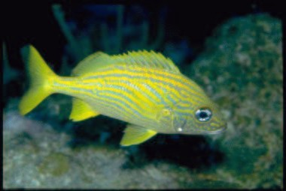

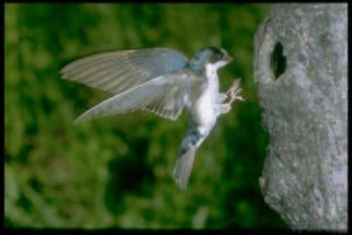
Annotate Images
SKY WATER TREE MOUNTAIN PEOPLE
SCOTLAND WATER FLOWER HILLS TREE
SKY WATER BUILDING PEOPLE WATER
FISH WATER OCEAN CORAL
PEOPLE MARKET PATTERN TEXTILE DISPLAY
BIRDS NEST TREE BRANCH LEAVES

Slide 7
So what is “topic”?
Loose idea: a grouping of words that are likely to appear in the same context
A hidden structure that helps determine what words are likely to appear in a corpus
but the underlying structure is different from what you’ve seen before – it’s not syntax
e.g. if “war” and “military” appear in a document, you probably won’t be surprised to find that “troops” appears later on
why? it’s not because they’re all nouns
…though you might say they all belong to the same topic

Slide 8



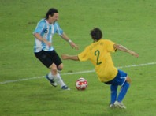

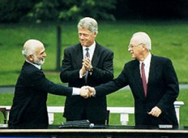
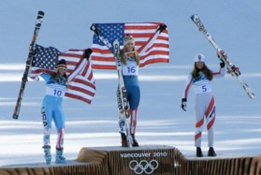
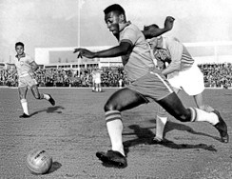





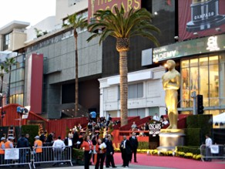
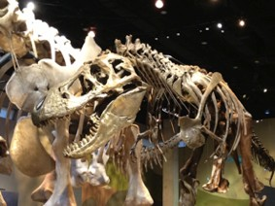


Document Clustering - Discover groups of related documents

Slide 9


























Document representation
x_{i} =
 |  |  | t | f- | df | v | c | o | r
i e t

Slide 10





K means can cluster articles into groups
Doc labeled with a topic assignment
Clustering goal: discover groups of related docs

Slide 11












Mixture of Gaussians for clustering documents
Space of all documents
(really lives in R^{V} for vocab size V)
Make soft assignments of docs to each Gaussian

Slide 12
Are documents about just one thing?
Is this article just about science?

Slide 13

Soft assignments capture uncertainty
Soft assignment r_{ik} tells us this doc could be about world news or science
But, clustering model still specifies each doc belongs to 1 topic

Slide 14

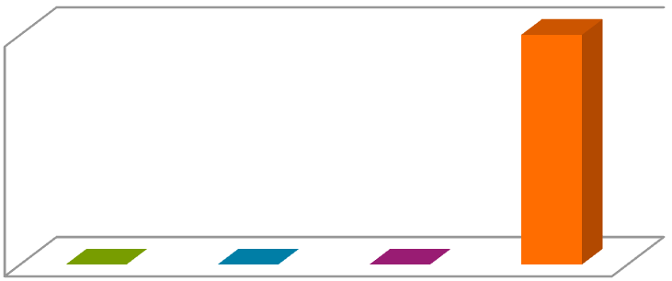


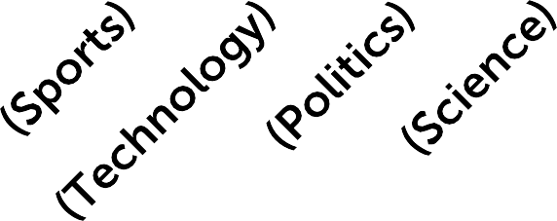
Modeling the Complex Dynamics and Changing Correlations of Epileptic Events
Drausin F. Wulsinª, Emily B. Fox^{c}, Brian Litt^{a,b}
Encoding of cluster
a
Department of Bioengineering, University of Pennsylvania, Philadelphia, PA ^{b}Department of Neurology, University of Pennsylvania, Philadelphia, PA ^{c}Department of Statistics, University of Washington, Seattle, WA
membership z = 4
Based on science
i
related words, maybe doc in cluster 4
Abstract
Patients with
can manifest short, sub-clinical epileptic “bursts” in
epilepsy
ull-blown | clinical | seizures.
addition to f We believe the relationship between these two classes of events—something not previously studied quantitatively— could yield important insights into the nature and intrinsic dynamics of
seizures. A goal of our work is to parse these complex epileptic events
1
into distinct dynamic regimes. A challenge posed by the intracranial EEG
(iEEG) data we study is the fact that the number and placement of electrodes can vary between patients. We develop a Bayesian nonparametric Markov
switching process that allows for (i) shared dynamic regimes between a vari- able number of channels, (ii) asynchronous regime-switching, and (iii) an unknown dictionary of dynamic regimes. We encode a sparse and changing set of dependencies between the channels using a Markov-switching Gaussian graphical model for the innovations process driving the channel dynamics and demonstrate the importance of this model in parsing and out-of-sample pre-
0
dictions of iEEG data. We show that our model produces intuitive state assignments that can help automate and enable the comparison of sub-clinical bursts
Keywords: Bayesian nonparametric, EEG, factorial hidden Markov model, graphical model, time series
clinical | analysis of |  | seizures
and full | clinical | seizures |  | .
1. Introduction
Despite over three decades of research, we still have very little idea of
what defines a seizure. This ignorance stems both from the complexity of epilepsy as a disease and a paucity of quantitative tools that are flexible

Slide 15

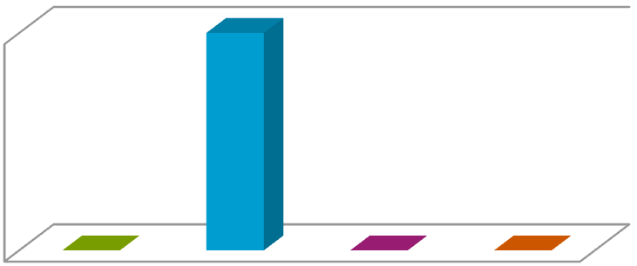

Modeling the Complex Dynamics and Changing Correlations of Epileptic Events
Drausin F. Wulsinª, Emily B. Fox^{c}, Brian Litt^{a,b}
Encoding of cluster
a
Department of Bioengineering, University of Pennsylvania, Philadelphia, PA ^{b}Department of Neurology, University of Pennsylvania, Philadelphia, PA ^{c}Department of Statistics, University of Washington, Seattle, WA
membership z = 2
i
Abstract
Patients with epilepsy can manifest short, sub-clinical epileptic “bursts” in
Or maybe cluster 2 (technology) is a better fit
ad
dition to full-blown clinical seizures. We believe the relationship between
se two classes of events—something not previously studied quantitatively— ld yield important insights into the nature and intrinsic dynamics ures. A goal of our work is to parse these complex epileptic eve
o distinct dynamic regimes. A challenge posed by the intracranial E EG) data we study is the fact that the number and placement of electro vary between patients. We develop a Bayesian nonparametric Mark tching process that allows for (i) shared dynamic regimes between a var le number of channels, (ii) asynchronous regime-switching, and (iii) known dictionary of dynamic regimes. We encode a sparse and chang of dependencies between the channels using a Markov-switching Gauss
the
Soft assignments capture uncertainty
cou seiz
of
nts EG
des
1
int (iE
can
in z = 2 or 4
ov
swi
i
i- an
ab un set
ing
0
ian
graphical model for the process driving the channel dynamics and
innovations
demonstrate the importance of this model in parsing and out-of-sample pre- dictions of iEEG data. We show that our model produces intuitive state assignments that can help automate clinical analysis of seizures and enable the comparison of sub-clinical bursts and full clinical seizures.
Keywords: Bayesian nonparametric, EEG, factorial hidden Markov graphical model, time series
model,
1. Introduction
Despite over three decades of research, we still have very little idea of
what defines a seizure. This ignorance stems both from the complexity of epilepsy as a disease and a paucity of quantitative tools that are flexible

Slide 16
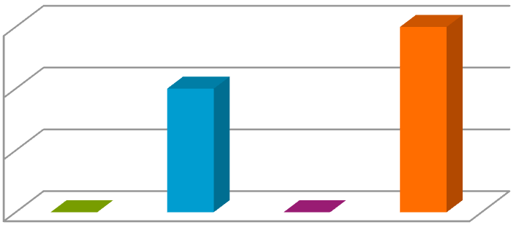


Modeling the Complex Dynamics and Changing Correlations of Epileptic Events
Drausin F. Wulsinª, Emily B. Fox^{c}, Brian Litt^{a,b}
ªDepartment of Bioengineering, University of Pennsylvania, Philadelphia, PA ^{b}Department of Neurology, University of Pennsylvania, Philadelphia, PA ^{c}Department of Statistics, University of Washington, Seattle, WA
Abstract
Really, it’s about science
and technology
Patients with addition to f
can manifest short, sub-clinical epileptic “bursts” in
epilepsy
ull-blown | clinical | seizures.
We believe the relationship between
these two classes of events—something not previously studied quantitatively— could yield important insights into the nature and intrinsic dynamics of
seizu ents
0.6
0.4
0.2
0
into (iEE
can
res. A goal of our work is to parse these complex epileptic ev
distinct dynamic regimes. A challenge posed by the intracranial E
G) data we study is the fact that the number and placement of electro vary between patients. We develop a Bayesian nonparametric Mar hing process that allows for (i) shared dynamic regimes between a v number of channels, (ii) asynchronous regime-switching, and (iii) own dictionary of dynamic regimes. We encode a sparse and chan
dependencies between the channels using a Markov-switching Gaus
EG
“z ” is both 2 and 4
des
switc
kov
i
ari- an
able
unkn
ging
set of
sian
graphical model for the innovations process driving the channel dynamics and
demonstrate the importance of this model in parsing and out-of-sample pre- dictions of iEEG data. We show that our model produces intuitive state assignments that can help automate clinical analysis of seizures and enable the comparison of sub-clinical bursts and full clinical seizures.
Keywords: Bayesian nonparametric, EEG, factorial hidden Markov graphical model, time series
model,
1. Introduction
Despite over three decades of research, we still have very little idea of
what defines a seizure. This ignorance stems both from the complexity of epilepsy as a disease and a paucity of quantitative tools that are flexible

Slide 17
Bag-of-words representation
Modeling the Complex Dynamics and Changing Correlations of Epileptic Events
Drausin F. Wulsinª, Emily B. Fox^{c}, Brian Litt^{a,b}
ªDepartment of Bioengineering, University of Pennsylvania, Philadelphia, PA ^{b}Department of Neurology, University of Pennsylvania, Philadelphia, PA ^{c}Department of Statistics, University of Washington, Seattle, WA
Abstract
Patients with epilepsy can manifest short, sub-clinical epileptic “bursts” in addition to full-blown clinical seizures. We believe the relationship between these two classes of events—something not previously studied quantitatively— could yield important insights into the nature and intrinsic dynamics of seizures. A goal of our work is to parse these complex epileptic events into distinct dynamic regimes. A challenge posed by the intracranial EEG (iEEG) data we study is the fact that the number and placement of electrodes can vary between patients. We develop a Bayesian nonparametric Markov switching process that allows for (i) shared dynamic regimes between a vari- able number of channels, (ii) asynchronous regime-switching, and (iii) an unknown dictionary of dynamic regimes. We encode a sparse and changing set of dependencies between the channels using a Markov-switching Gaussian graphical model for the innovations process driving the channel dynamics and demonstrate the importance of this model in parsing and out-of-sample pre- dictions of iEEG data. We show that our model produces intuitive state assignments that can help automate clinical analysis of seizures and enable the comparison of sub-clinical bursts and full clinical seizures.
Keywords: Bayesian nonparametric, EEG, factorial hidden Markov model, graphical model, time series
x = { modeling, complex, epilepsy,
i
modeling, Bayesian, clinical, epilepsy, EEG, data, dynamic…}
multiset
= unordered set of words with duplication of unique elements mattering
1. Introduction
Despite over three decades of research, we still have very little idea of what defines a seizure. This ignorance stems both from the complexity of epilepsy as a disease and a paucity of quantitative tools that are flexible

Slide 18
A model for bag-of-words representation
Modeling the Complex Dynamics and Changing Correlations of Epileptic Events
Drausin F. Wulsinª, Emily B. Fox^{c}, Brian Litt^{a,b}
ªDepartment of Bioengineering, University of Pennsylvania, Philadelphia, PA ^{b}Department of Neurology, University of Pennsylvania, Philadelphia, PA ^{c}Department of Statistics, University of Washington, Seattle, WA
Abstract
Patients with epilepsy can manifest short, sub-clinical epileptic “bursts” in addition to full-blown clinical seizures. We believe the relationship between these two classes of events—something not previously studied quantitatively— could yield important insights into the nature and intrinsic dynamics of seizures. A goal of our work is to parse these complex epileptic events into distinct dynamic regimes. A challenge posed by the intracranial EEG (iEEG) data we study is the fact that the number and placement of electrodes can vary between patients. We develop a Bayesian nonparametric Markov switching process that allows for (i) shared dynamic regimes between a vari- able number of channels, (ii) asynchronous regime-switching, and (iii) an unknown dictionary of dynamic regimes. We encode a sparse and changing set of dependencies between the channels using a Markov-switching Gaussian graphical model for the innovations process driving the channel dynamics and demonstrate the importance of this model in parsing and out-of-sample pre- dictions of iEEG data. We show that our model produces intuitive state assignments that can help automate clinical analysis of seizures and enable the comparison of sub-clinical bursts and full clinical seizures.
Keywords: Bayesian nonparametric, EEG, factorial hidden Markov model, graphical model, time series
1. Introduction
Despite over three decades of research, we still have very little idea of what defines a seizure. This ignorance stems both from the complexity of epilepsy as a disease and a paucity of quantitative tools that are flexible
As before, the “prior” probability that doc i is from topic k is:
p(z = k) = π
i k
π = [π
π … π ]
1 2 K
represents corpus-wide topic prevalence

Slide 19




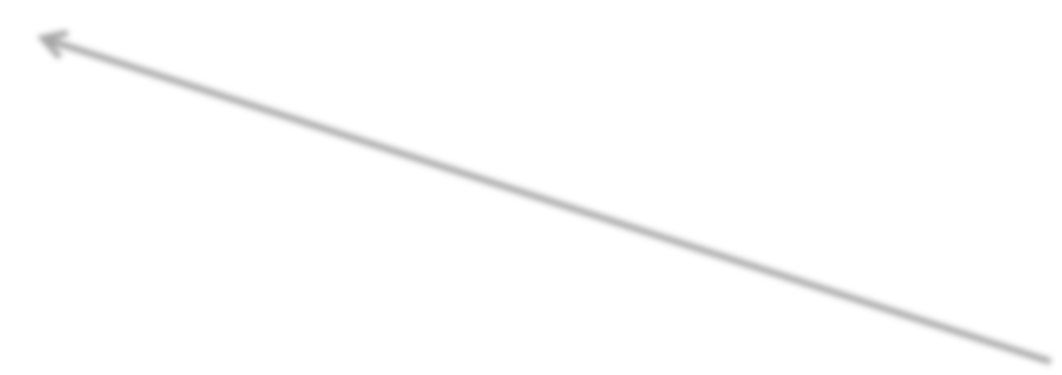













A model for bag-of-words representation
Modeling the Complex Dynamics and Changing Correlations of Epileptic Events
Drausin F. Wulsinª, Emily B. Fox^{c}, Brian Litt^{a,b}
ªDepartment of Bioengineering, University of Pennsylvania, Philadelphia, PA ^{b}Department of Neurology, University of Pennsylvania, Philadelphia, PA ^{c}Department of Statistics, University of Washington, Seattle, WA
Abstract
Patients with epilepsy can manifest short, sub-clinical epileptic “bursts” in addition to full-blown clinical seizures. We believe the relationship between these two classes of events—something not previously studied quantitatively— could yield important insights into the nature and intrinsic dynamics of seizures. A goal of our work is to parse these complex epileptic events into distinct dynamic regimes. A challenge posed by the intracranial EEG (iEEG) data we study is the fact that the number and placement of electrodes can vary between patients. We develop a Bayesian nonparametric Markov switching process that allows for (i) shared dynamic regimes between a vari- able number of channels, (ii) asynchronous regime-switching, and (iii) an unknown dictionary of dynamic regimes. We encode a sparse and changing set of dependencies between the channels using a Markov-switching Gaussian graphical model for the innovations process driving the channel dynamics and demonstrate the importance of this model in parsing and out-of-sample pre- dictions of iEEG data. We show that our model produces intuitive state assignments that can help automate clinical analysis of seizures and enable the comparison of sub-clinical bursts and full clinical seizures.
Keywords: Bayesian nonparametric, EEG, factorial hidden Markov model, graphical model, time series
1. Introduction
Despite over three decades of research, we still have very little idea of what defines a seizure. This ignorance stems both from the complexity of epilepsy as a disease and a paucity of quantitative tools that are flexible
Assuming doc i is from topic k, words occur with probabilities:
SCIENCE
patients | 0.05
clinical | 0.01
epilepsy | 0.002
seizures | 0.0015
EEG | 0.001
… | …
words in vocab

Slide 20






Topic-specific word probabilities
Distribution on words in vocab for each topic
SCIENCE
experiment | 0.1
test | 0.08
discover | 0.05
hypothesize | 0.03
climate | 0.01
… | …
TECH
develop | 0.18
computer | 0.09
processor | 0.032
user | 0.027
internet | 0.02
… | …
SPORTS
player | 0.15
score | 0.07
team | 0.06
goal | 0.03
injury | 0.01
… | …
…
(table now organized by decreasing probabilities showing top words in each category)

Slide 21































Comparing and contrasting
Previously
p(z_{i} = k) = π_{k}
Now
p(z_{i} = k) = π_{k}
Prior topic probabilities
Likelihood under each topic
tf-idf ve
SCIENCE |  |  | TECH |  |  | SPORTS
experiment | 0.1 |  | develop | 0.18 |  | player | 0.15
test | 0.08 |  | computer | 0.09 |  | score | 0.07
discover | 0.05 |  | processor | 0.032 |  | team | 0.06
hypothesize | 0.03 |  | user | 0.027 |  | goal | 0.03
climate | 0.01 |  | internet | 0.02 |  | injury | 0.01
… | … |  | … | … |  | … | …
…
{modeling, complex, epilepsy, modeling, Bayesian, clinical,
epilepsy, EEG, data, dynamic…}
compute likelihood of the collection of words in doc under each topic distribution
ct
o
r
compute likelihood of tf-idf
vector under each Gaussian

Slide 22
Mixed membership models
Modeling the Complex Dynamics and Changing Correlations of Epileptic Events
Drausin F. Wulsinª, Emily B. Fox^{c}, Brian Litt^{a,b}
ªDepartment of Bioengineering, University of Pennsylvania, Philadelphia, PA ^{b}Department of Neurology, University of Pennsylvania, Philadelphia, PA ^{c}Department of Statistics, University of Washington, Seattle, WA
Abstract
Want to discover a
set of memberships
(In contrast, cluster models aim at discovering a single membership)
Patients with
can manifest short, sub-clinical epileptic “bursts” in
epilepsy
ull-blown | clinical | seizures.
addition to f We believe the relationship between these two classes of events—something not previously studied quantitatively— could yield important insights into the nature and intrinsic dynamics of seizures. A goal of our work is to parse these complex epileptic events into distinct dynamic regimes. A challenge posed by the intracranial EEG (iEEG) data we study is the fact that the number and placement of electrodes can vary between patients. We develop a
switching process that allows for (i) shared dynamic regimes between a vari- able number of channels, (ii) asynchronous regime-switching, and (iii) an
Bayesian | nonparametric | Markov
unknown dictionary of dynamic regimes. We encode a and changing
sparse
set of dependencies between the channels using a Markov-switching Gaussian graphical model for the innovations process driving the channel dynamics and demonstrate the importance of this model in parsing and out-of-sample pre- dictions of iEEG data. We show that our model produces intuitive state assignments that can help automate clinical analysis of seizures and enable the comparison of sub-clinical bursts and full clinical seizures.
Keywords: Bayesian nonparametric, EEG, factorial hidden Markov graphical model, time series
model,
1. Introduction
Despite over three decades of research, we still have very little idea of
what defines a seizure. This ignorance stems both from the complexity of epilepsy as a disease and a paucity of quantitative tools that are flexible

Slide 23
Document as a mixture of topics
government 0.3 response 0.2 ...
[ Criticism of government response to the hurricane primarily consisted of criticism of its response to the approach of the storm and its aftermath, specifically in the delayed response ] to the [ flooding of New Orleans. … 80% of the 1.3 million residents of the greater New Orleans metropolitan area evacuated ] …[ Over seventy countries pledged monetary donations or other assistance]. …
Topic θ₁
city 0.2 new 0.1 orleans 0.05 ...
Topic θ₂
…
How can we discover these topic-word distributions?
Many applications would be enabled by discovering such topics
Summarize themes/aspects
Facilitate navigation/browsing
Retrieve documents
Segment documents
Many other text mining tasks
donate 0.1 relief 0.05 help 0.02 ...
Topic θ_{k}
is 0.05 the 0.04 a 0.03 ...
Background θ_{k}

Slide 24
Document as a mixture of topics
A document is a collection of terms
A term is a single lexical token (usually one or more words, but can be any arbitrary string).
A topic is a distribution over terms. Each term has a different probability within a topic. The higher the probability, the more relevant is a term for that topic.
Several topics may have a high probability associated with the same term. For example, the word “house” may be found in a topic related to properties but also in a topic related to holiday accommodation.
Each document will have a probability associated with each topic according to the terms in the document.

Slide 25
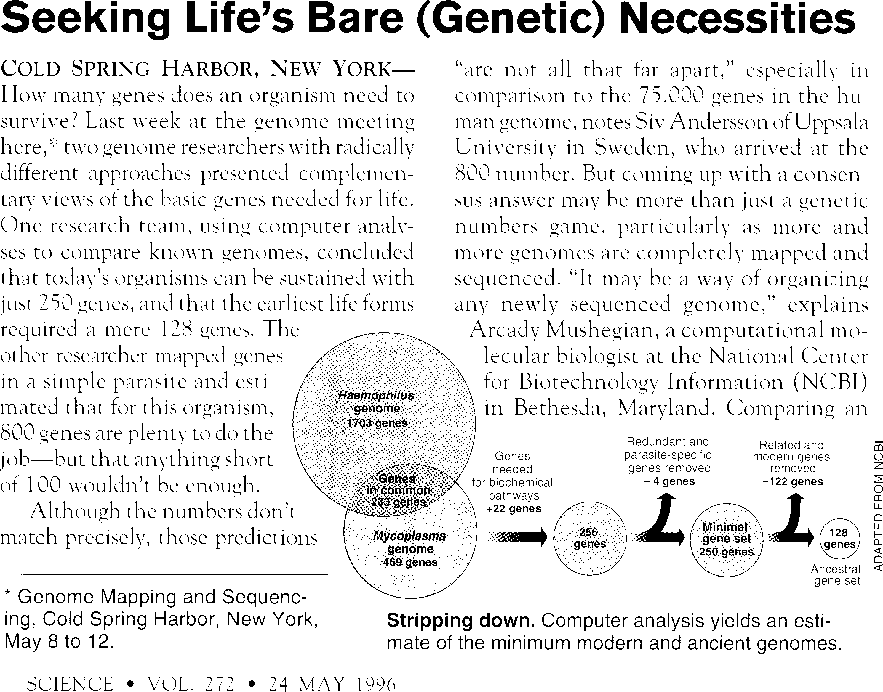
Intuition behind Latent Dirichlet allocation (LDA)
Simple intuition: Documents exhibit multiple topics.

Slide 26


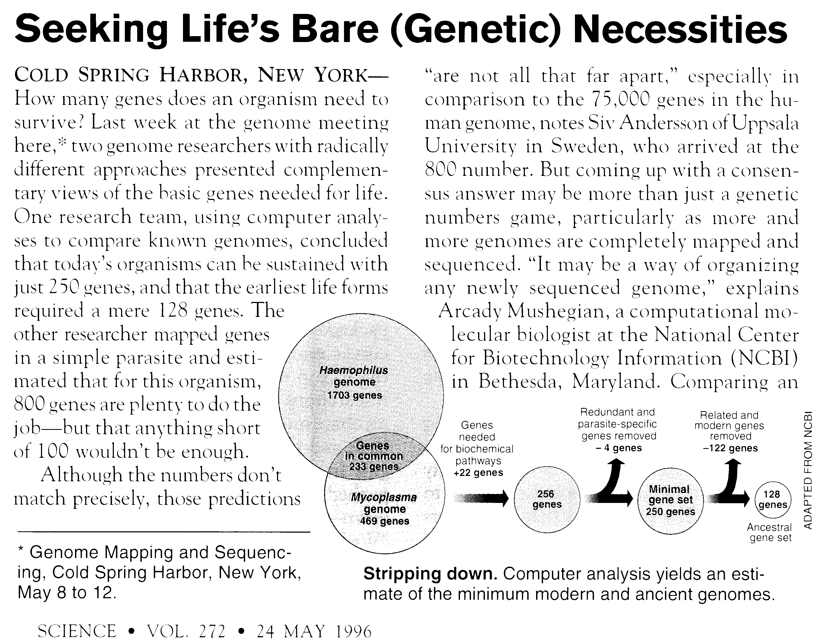
Generative Model
Topics
Documents
Topic proportions and assignments
gene dna
0.04
0.02
genetic 0.01
.,,
life 0.02
evolve 0.01
organism 0.01
.,,
brain neuron nerve
...
0.04
0.02
0.01
data number
0.02
0.02
computer 0.01
.,,
Each topic is a distribution over words
Each document is a mixture of corpus-wide topics
Each word is drawn from one of those topics

Slide 27


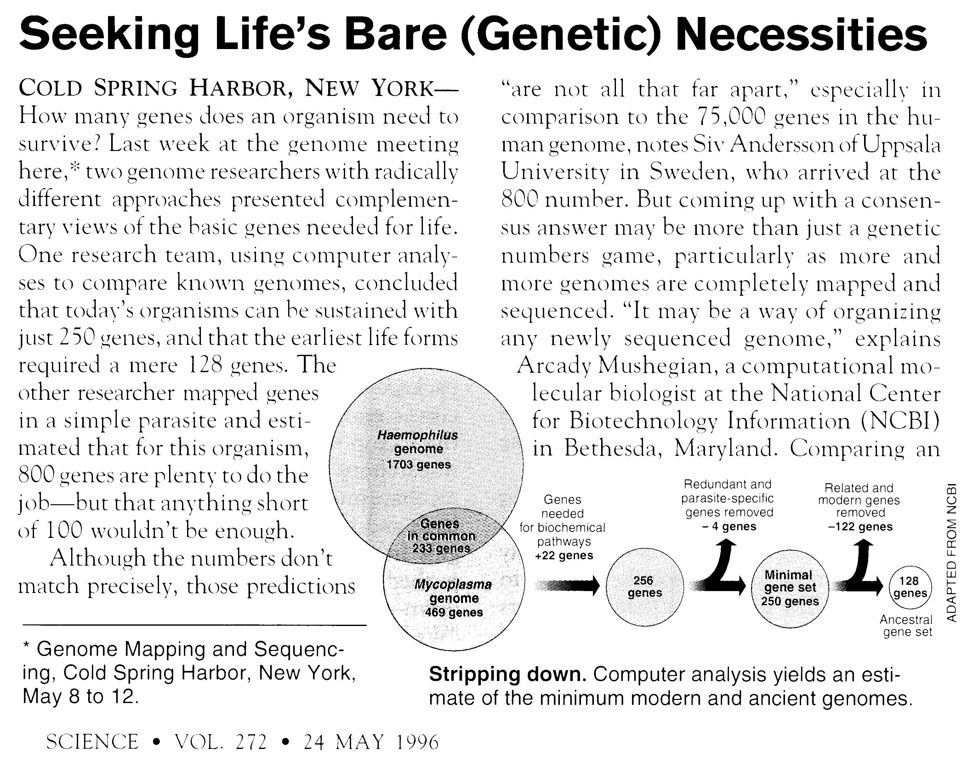
Latent Dirichlet allocation (LDA)
Topics
Documents
Topic proportions and assignments
In reality, we only observe the documents
The other structure are hidden variables

Slide 28
The posterior distribution
Topics
Documents
Topic proportions and assignments
Our goal is to infer the hidden variables
I.e., compute their distribution conditioned on the documents
p(topics, proportions, assignments | documents)

Slide 29
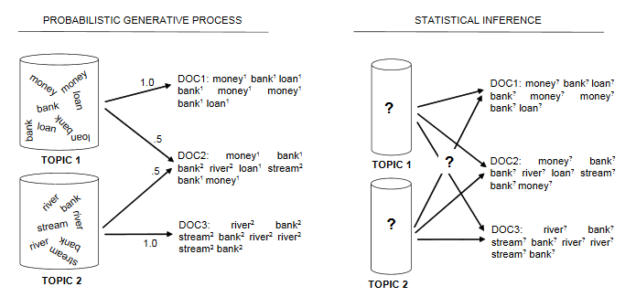
Latent Dirichlet allocation (LDA)

Slide 30
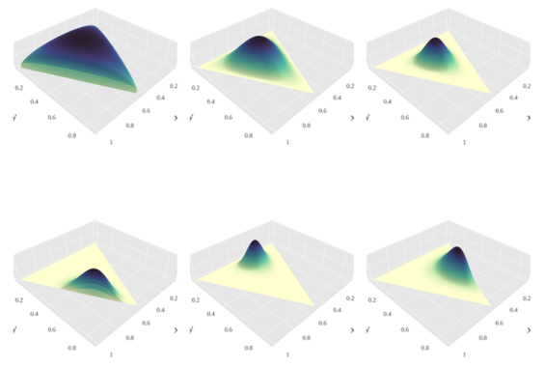
Dirichlet Distribution
Continuous multivariate probability distribution
Denote Dir(α)
Dirichlet distributions are commonly used as prior distributions in Bayesian statistics
The topic proportions are a K dimensional Dirichlet.
The topics are a V dimensional Dirichlet.

Slide 31


LDA is a mixed membership model
Modeling the Complex Dynamics and Changing Correlations of Epileptic Events
Drausin F. Wulsinª, Emily B. Fox^{c}, Brian Litt^{a,b}
ªDepartment of Bioengineering, University of Pennsylvania, Philadelphia, PA ^{b}Department of Neurology, University of Pennsylvania, Philadelphia, PA ^{c}Department of Statistics, University of Washington, Seattle, WA
LDA is a probabilistic model of text
It lets us visualize the hidden thematic structure in large collections, and generalize new data to fit into that structure.
Abstract
Patients with
can manifest short, sub-clinical epileptic “bursts” in
epilepsy
ull-blown | clinical | seizures.
addition to f We believe the relationship between these two classes of events—something not previously studied quantitatively— could yield important insights into the nature and intrinsic dynamics of seizures. A goal of our work is to parse these complex epileptic events into distinct dynamic regimes. A challenge posed by the intracranial EEG (iEEG) data we study is the fact that the number and placement of electrodes can vary between patients. We develop a
switching process that allows for (i) shared dynamic regimes between a vari- able number of channels, (ii) asynchronous regime-switching, and (iii) an
Want to discover a set of topics
Bayesian | nonparametric | Markov
0.6
0.4
0.2
0
unknown dictionary of dynamic regimes. We encode a and changing
sparse
set of dependencies between the channels using a Markov-switching Gaussian graphical model for the innovations process driving the channel dynamics and demonstrate the importance of this model in parsing and out-of-sample pre- dictions of iEEG data. We show that our model produces intuitive state assignments that can help automate clinical analysis of seizures and enable the comparison of sub-clinical bursts and full clinical seizures.
Keywords: Bayesian nonparametric, EEG, factorial hidden Markov graphical model, time series
1. Introduction
Despite over three decades of research, we still have very little idea of what defines a seizure. This ignorance stems both from the complexity of
model,
epilepsy as a and a paucity of quantitative tools that are flexible
disease

Slide 32



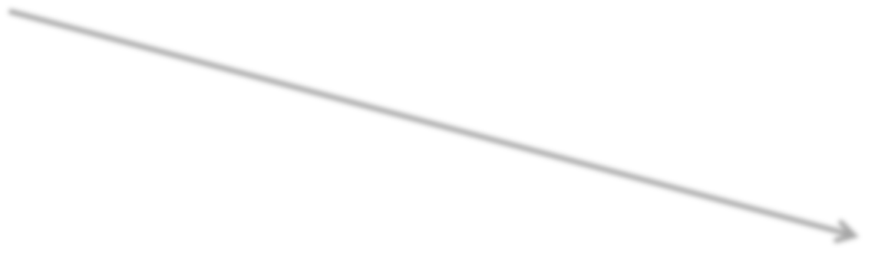
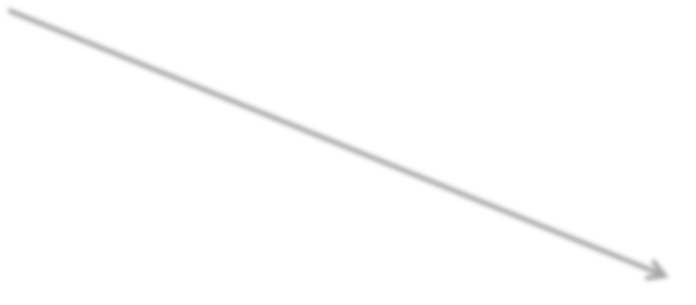

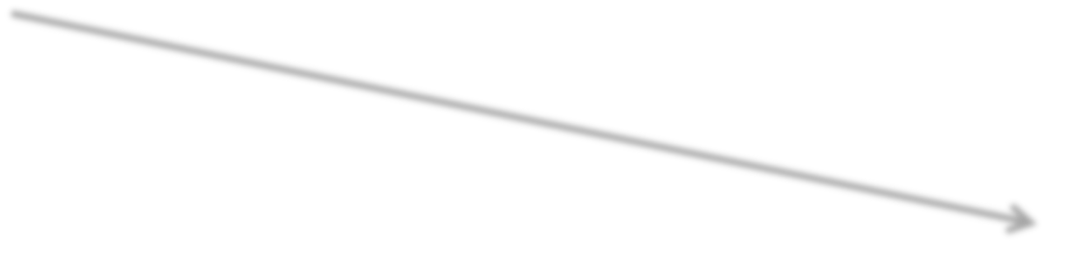














Modeling the Complex Dynamics and Changing Correlations of Epileptic Events
Topic vocab distributions:
Clustering:
One topic indicator z_{i} per document i
Drausin F. Wulsinª, Emily B. Fox^{c}, Brian Litt^{a,b}
ªDepartment of Bioengineering, University of Pennsylvania, Philadelphia, PA ^{b}Department of Neurology, University of Pennsylvania, Philadelphia, PA ^{c}Department of Statistics, University of Washington, Seattle, WA
SCIENCE
experiment
0.1
test
0.08
Abstract
Patients with epilepsy can manifest short, sub-clinical epileptic “bursts” in addition to full-blown clinical seizures. We believe the relationship between these two classes of events—something not previously studied quantitatively— could yield important insights into the nature and intrinsic dynamics of seizures. A goal of our work is to parse these complex epileptic events into distinct dynamic regimes. A challenge posed by the intracranial EEG (iEEG) data we study is the fact that the number and placement of electrodes can vary between patients. We develop a Bayesian nonparametric Markov switching process that allows for (i) shared dynamic regimes between a vari- able number of channels, (ii) asynchronous regime-switching, and (iii) an unknown dictionary of dynamic regimes. We encode a sparse and changing set of dependencies between the channels using a Markov-switching Gaussian graphical model for the innovations process driving the channel dynamics and demonstrate the importance of this model in parsing and out-of-sample pre- dictions of iEEG data. We show that our model produces intuitive state assignments that can help automate clinical analysis of seizures and enable the comparison of sub-clinical bursts and full clinical seizures.
Keywords: Bayesian nonparametric, EEG, factorial hidden Markov model, graphical model, time series
discover
0.05
hypothesize
0.03
climate
0.01
…
…
All words come from (get scored under) same topic z
TECH
develop 0.18
computer 0.09
processor 0.032
user 0.027
internet 0.02
… …
i
Distribution on prevalence of topics in corpus
SPORTS
player | 0.15
score | 0.07
team | 0.06
goal | 0.03
injury | 0.01
… | …
π = [π₁ π₂ … π_{K}]
1. Introduction
Despite over three decades of research, we still have very little idea of what defines a seizure. This ignorance stems both from the complexity of epilepsy as a disease and a paucity of quantitative tools that are flexible
…

Slide 33




























Modeling the Complex Dynamics and Changing Correlations of Epileptic Events
Same topic distributions:
In LDA:
One topic indicator z_{iw} per word in doc i
Drausin F. Wulsinª, Emily B. Fox^{c}, Brian Litt^{a,b}
ªDepartment of Bioengineering, University of Pennsylvania, Philadelphia, PA ^{b}Department of Neurology, University of Pennsylvania, Philadelphia, PA ^{c}Department of Statistics, University of Washington, Seattle, WA
SCIENCE
experiment
0.1
test
0.08
Abstract
discover
0.05
hypothesize
0.03
Patients with epilepsy
can manifest short, sub-clinical epileptic “bursts” in
climate
0.01
addition to full-blown clinical seizures. We believe the relationship between these two classes of events—something not previously studied quantitatively— could yield important insights into the nature and intrinsic dynamics of
…
…
Each word gets scored under its topic z
TECH
develop 0.18
computer 0.09
processor 0.032
user 0.027
internet 0.02
… …
seizures. A goal of our work is to parse these complex epileptic events
into distinct dynamic regimes. A challenge posed by the intracranial EEG
(iEEG) data we study is the fact that the number and placement of electrodes can vary between patients. We develop a Bayesian nonparametric Markov switching process that allows for (i) shared dynamic regimes between a vari-
iw
able number of channels, (ii) asynchronous regime-switching, and (iii) an
unknown dictionary of dynamic regimes. We encode a sparse and changing
set of dependencies between the channels using a Markov-switching Gaussian
Distribution on prevalence of topics in document
graphical model for the innovations process driving the channel dynamics and demonstrate the importance of this model in parsing and out-of-sample pre- dictions of iEEG data. We show that our model produces intuitive state assignments that can help automate clinical analysis of seizures and enable the comparison of sub-clinical bursts and full clinical seizures.
SPORTS
player 0.15
score 0.07
team 0.06
goal 0.03
injury 0.01
… …
Keywords: Bayesian nonparametric, EEG, factorial hidden Markov model,
π_{i} = [π_{i1} π_{i2} … π_{iK}]
graphical model, time series
1. Introduction
Despite over three decades of research, we still have very little idea of what defines a seizure. This ignorance stems both from the complexity of
…
epilepsy as a and a paucity of quantitative tools that are flexible
disease

Slide 34
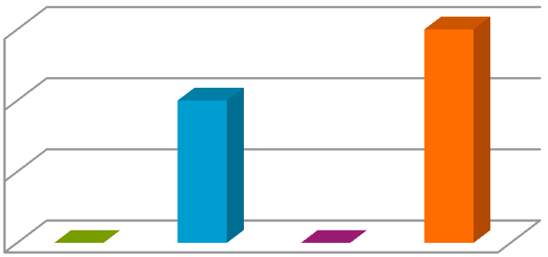
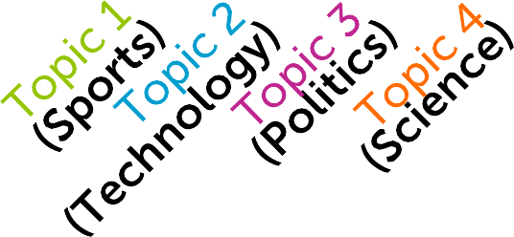
Document topic proportions:
Modeling the Complex Dynamics and Changing Correlations of Epileptic Events
Topic vocab distributions:
Drausin F. Wulsinª, Emily B. Fox^{c}, Brian Litt^{a,b}
ªDepartment of Bioengineering, University of Pennsylvania, Philadelphia, PA ^{b}Department of Neurology, University of Pennsylvania, Philadelphia, PA ^{c}Department of Statistics, University of Washington, Seattle, WA
π_{i} = [π_{i1} π_{i2} … π_{iK}]
SCIENCE
experiment | 0.1
test | 0.08
discover | 0.05
hypothesize | 0.03
climate | 0.01
… | …
0.6
0.4
0.2
0
Abstract
Patients with
can manifest short, sub-clinical epileptic “bursts” in
epilepsy
ull-blown | clinical | seizures.
addition to f We believe the relationship between these two classes of events—something not previously studied quantitatively— could yield important insights into the nature and intrinsic dynamics of
seizures. A goal of our work is to parse these complex epileptic events
TECH
develop | 0.18
computer | 0.09
processor | 0.032
user | 0.027
internet | 0.02
… | …
into distinct dynamic regimes. A challenge posed by the intracranial EEG
(iEEG) data we study is the fact that the number and placement of electrodes can vary between patients. We develop a
switching process that allows for (i) shared dynamic regimes between a vari- able number of channels, (ii) asynchronous regime-switching, and (iii) an
Bayesian | nonparametric | Markov
unknown dictionary of dynamic regimes. We encode a and changing
sparse
set of dependencies between the channels using a Markov-switching Gaussian graphical model for the innovations process driving the channel dynamics and demonstrate the importance of this model in parsing and out-of-sample pre- dictions of iEEG data. We show that our model produces intuitive state assignments that can help automate clinical analysis of seizures and enable the comparison of sub-clinical bursts and full clinical seizures.
SPORTS
player | 0.15
score | 0.07
team | 0.06
goal | 0.03
injury | 0.01
… | …
Keywords: Bayesian nonparametric, EEG, factorial hidden Markov graphical model, time series
1. Introduction
model,
Despite over three decades of research, we still have very little idea of what defines a seizure. This ignorance stems both from the complexity of
…
epilepsy as a and a paucity of quantitative tools that are flexible
disease

Slide 35
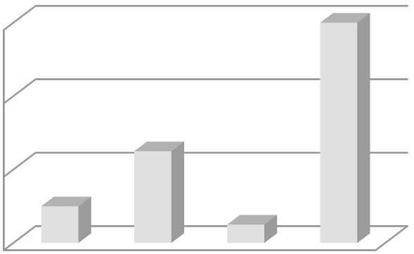






























































Modeling the Complex Dynamics and Changing Correlations of Epileptic Events
Topic vocab distributions:
Document topic proportions:
Drausin F. Wulsinª, Emily B. Fox^{c}, Brian Litt^{a,b}
ªDepartment of Bioengineering, University of Pennsylvania, Philadelphia, PA ^{b}Department of Neurology, University of Pennsylvania, Philadelphia, PA ^{c}Department of Statistics, University of Washington, Seattle, WA
π_{i} = [π_{i1} π_{i2} … π_{iK}]
TOPIC 1
Word 1 | ?
Word 2 | ?
Word 3 | ?
Word 4 | ?
Word 5 | ?
… | …
0.6
0.4
0.2
0
Abstract
Patients with
epilepsy
can manifest short, sub-clinical epileptic “bursts” in
addition to full-blown clinical seizures. We believe the relationship between
these two classes of events—something not previously studied quantitatively— could yield important insights into the nature and intrinsic dynamics of
? ? ? ?
seizures. A goal of our work is to parse these complex epileptic events
TOPIC 2
Word 1 | ?
Word 2 | ?
Word 3 | ?
Word 4 | ?
Word 5 | ?
… | …
into distinct dynamic regimes. A challenge posed by the intracranial EEG
(iEEG) data we study is the fact that the number and placement of electrodes
can vary between patients. We develop a
Bayesian | nonparametric | Markov
switching process that allows for (i) shared dynamic regimes between a vari- able number of channels, (ii) asynchronous regime-switching, and (iii) an
unknown dictionary of dynamic regimes. We encode a and changing
sparse
set of dependencies between the channels using a Markov-switching Gaussian graphical model for the innovations process driving the channel dynamics and demonstrate the importance of this model in parsing and out-of-sample pre- dictions of iEEG data. We show that our produces intuitive state assignments that can help and enable
the comparison of sub-clinical bursts and full .
Keywords: Bayesian nonparametric, EEG, factorial hidden Markov model, graphical model, time series
1. Introduction
Despite over three decades of research, we still have very little idea of what defines a seizure. This ignorance stems both from the complexity of
TOPIC 3
Word 1 | ?
Word 2 | ?
Word 3 | ?
Word 4 | ?
Word 5 | ?
… | …
 |  | model
automate | clinical | analysis of |  |  |  | seizures
 |  |  | clinical |  | seizures
…
epilepsy as a and a paucity of quantitative tools that are flexible
disease

Slide 36
















Modeling the Complex Dynamics and Changing Correlations of Epileptic Events
Topic vocab distributions:
Document topic proportions:
Drausin F. Wulsinª, Emily B. Fox^{c}, Brian Litt^{a,b}
ªDepartment of Bioengineering, University of Pennsylvania, Philadelphia, PA ^{b}Department of Neurology, University of Pennsylvania, Philadelphia, PA ^{c}Department of Statistics, University of Washington, Seattle, WA
π_{i} = [π_{i1} π_{i2} … π_{iK}]
TOPIC 1
Word 1 | ?
Word 2 | ?
Word 3 | ?
Word 4 | ?
Word 5 | ?
… | …
Abstract 0.6
Patients with epilepsy can manifest short, sub-clinical epileptic “bursts” in addition to full-blown clinical seizures. We believe the relationship between 0.
these two classes of events—something not previously studied quantitatively—
could yield important insights into the nature and intrinsic dynamics of _{0.2}
seizures. A goal of our work is to parse these complex epileptic events
into distinct dynamic regimes. A challenge posed by the intracranial EEG
(iEEG) data we study is the fact that the number and placement of electrodes ₀
can vary between patients. We develop a Bayesian nonparametric Markov
switching process that allows for (i) shared dynamic regimes between a vari- able number of channels, (ii) asynchronous regime-switching, and (iii) an unknown dictionary of dynamic regimes. We encode a sparse and changing set of dependencies between the channels using a Markov-switching Gaussian graphical model for the innovations process driving the channel dynamics and demonstrate the importance of this model in parsing and out-of-sample pre- dictions of iEEG data. We show that our model produces intuitive state assignments that can help automate clinical analysis of seizures and enable the comparison of sub-clinical bursts and full clinical seizures.
Keywords: Bayesian nonparametric, EEG, factorial hidden Markov model, graphical model, time series
LDA inputs:
- Set of words per doc for each
4
doc in corpus
? ? ? ?
TOPIC 2
Word 1 | ?
Word 2 | ?
Word 3 | ?
Word 4 | ?
Word 5 | ?
… | …
LDA outputs:
Corpus-wide topic vocab distributions
Topic assignments per word
Topic proportions per doc
TOPIC 3
Word 1 | ?
Word 2 | ?
Word 3 | ?
Word 4 | ?
Word 5 | ?
… | …
1. Introduction
Despite over three decades of research, we still have very little idea of what defines a seizure. This ignorance stems both from the complexity of
…
epilepsy as a and a paucity of quantitative tools that are flexible
disease

Slide 37


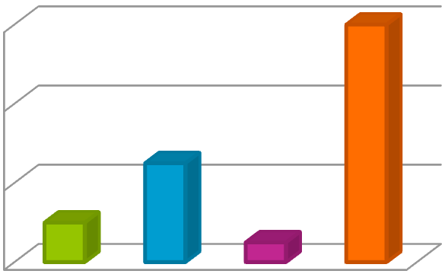


Interpreting LDA outputs
TOPIC 1
experiment | 0.1
test | 0.08
discover | 0.05
hypothesize | 0.03
climate | 0.01
… | …
Modeling the Complex Dynamics and Changing Correlations of Epileptic Events
0.6
0.4
0.2
0
Drausin F. Wulsinª, Emily B. Fox^{c}, Brian Litt^{a,b}
ªDepartment of Bioengineering, University of Pennsylvania, Philadelphia, PA ^{b}Department of Neurology, University of Pennsylvania, Philadelphia, PA ^{c}Department of Statistics, University of Washington, Seattle, WA
TOPIC 2
develop | 0.18
computer | 0.09
processor | 0.032
user | 0.027
internet | 0.02
… | …
Abstract
Patients with
can manifest short, sub-clinical epileptic “bursts” in
epilepsy
 | clinical | seizures.
addition to full-blown We believe the relationship between these two classes of events—something not previously studied quantitatively— could yield important insights into the nature and intrinsic dynamics of seizures. A goal of our work is to parse these complex epileptic events into distinct dynamic regimes. A challenge posed by the intracranial EEG (iEEG) data we study is the fact that the number and placement of electrodes can vary between patients. We develop a
switching process that allows for (i) shared dynamic regimes between a vari- able number of channels, (ii) asynchronous regime-switching, and (iii) an
Bayesian | nonparametric | Markov
unknown dictionary of dynamic regimes. We encode a and changing
sparse
set of dependencies between the channels using a Markov-switching Gaussian graphical model for the innovations process driving the channel dynamics and demonstrate the importance of this model in parsing and out-of-sample pre- dictions of iEEG data. produces intuitive state assignments that can help and enable
the comparison of sub-clinical bursts and full
Keywords: Bayesian nonparametric, EEG, factorial hidden Markov model, graphical model, time series
1. Introduction
Despite over three decades of research, we still have very little idea of what defines a seizure. This ignorance stems both from the complexity of epilepsy as a disease and a paucity of quantitative tools that are flexible
TOPIC 3
player | 0.15
score | 0.07
team | 0.06
goal | 0.03
injury | 0.01
… | …
We show that our |  | model
automate | clinical | analysis of |  |  | seizures
 |  | clinical |  | seizures |  | .
…

Slide 38
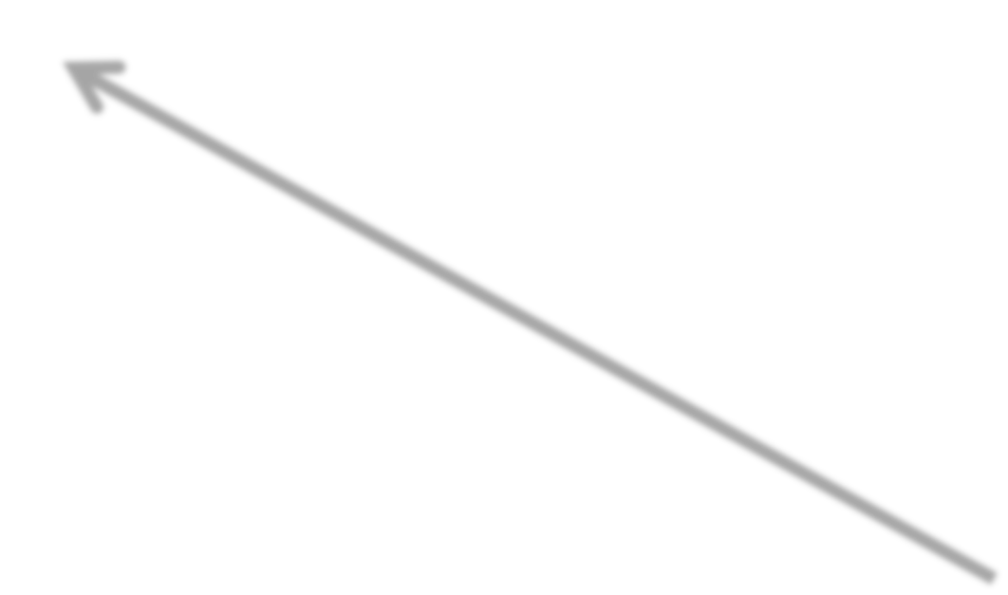


Interpreting LDA outputs
TOPIC 1
experiment | 0.1
test | 0.08
discover | 0.05
hypothesize | 0.03
climate | 0.01
… | …
Modeling the Complex Dynamics and Changing Correlations of Epileptic Events
0.6
0.4
0.2
0
Drausin F. Wulsinª, Emily B. Fox^{c}, Brian Litt^{a,b}
ªDepartment of Bioengineering, University of Pennsylvania, Philadelphia, PA ^{b}Department of Neurology, University of Pennsylvania, Philadelphia, PA ^{c}Department of Statistics, University of Washington, Seattle, WA
TOPIC 2
develop | 0.18
computer | 0.09
processor | 0.032
user | 0.027
internet | 0.02
… | …
Abstract
Patients with epilepsy
can manifest short, sub-clinical epileptic “bursts” in
addition to full-blown clinical seizures. We believe the relationship between these two classes of events—something not previously studied quantitatively— could yield important insights into the nature and intrinsic dynamics of
seizures. A goal of our work is to parse these complex epileptic events
into distinct dynamic regimes. A challenge posed by the intracranial EEG
(iEEG) data we study is the fact that the number and placement of electrodes can vary between patients. We develop a Bayesian nonparametric Markov switching process that allows for (i) shared dynamic regimes between a vari-
Examine coherence of learned topics
able number of channels, (ii) asynchronous regime-switching, and (iii) an
unknown dictionary of dynamic regimes. We encode a and changing
sparse
set of dependencies between the channels using a Markov-switching Gaussian
TOPIC 3
player | 0.15
score | 0.07
team | 0.06
goal | 0.03
injury | 0.01
… | …
graphical model for the innovations process driving the channel dynamics and
What are top words per topic?
Do they form meaningful groups?
Use to post-facto label topics
(e.g., science, tech, sports,…)
demonstrate the importance of this model in parsing and out-of-sample pre-
dictions of iEEG data. We show that our model assignments that can help automate clinical
produces intuitive state
analysis of
seizures and enable
the comparison of sub-clinical bursts and full clinical
seizures.
Keywords: Bayesian nonparametric, EEG, factorial hidden graphical model, time series
1. Introduction
Markov model,
Despite over three decades of research, we still have very little idea of
…
what defines a seizure. This ignorance stems both from the complexity of
epilepsy as a
disease and a paucity of quantitative tools that are flexible

Slide 39

Interpreting LDA outputs
TOPIC 1
experiment | 0.1
test | 0.08
discover | 0.05
hypothesize | 0.03
climate | 0.01
… | …
Modeling the Complex Dynamics and Changing Correlations of Epileptic Events
0.6
0.4
0.2
0
Drausin F. Wulsinª, Emily B. Fox^{c}, Brian Litt^{a,b}
ªDepartment of Bioengineering, University of Pennsylvania, Philadelphia, PA ^{b}Department of Neurology, University of Pennsylvania, Philadelphia, PA ^{c}Department of Statistics, University of Washington, Seattle, WA
TOPIC 2
develop | 0.18
computer | 0.09
processor | 0.032
user | 0.027
internet | 0.02
… | …
Abstract
Patients with
can manifest short, sub-clinical epileptic “bursts” in
epilepsy
 | clinical | seizures.
addition to full-blown We believe the relationship between these two classes of events—something not previously studied quantitatively— could yield important insights into the nature and intrinsic dynamics of
seizures. A goal of our work is to parse these complex epileptic events
into distinct dynamic regimes. A challenge posed by the intracranial EEG
(iEEG) data we study is the fact that the number and placement of electrodes
can vary between patients. We develop a
Bayesian | nonparametric | Markov
switching process that allows for (i) shared dynamic regimes between a vari-
able number of channels, (ii) asynchronous regime-switching, and (iii) an
unknown dictionary of dynamic regimes. We encode a and changing
sparse
Doc-specific topic proportions can be used to:
set of dependencies between the channels using a Markov-switching Gaussian
TOPIC 3
player | 0.15
score | 0.07
team | 0.06
goal | 0.03
injury | 0.01
… | …
graphical model for the innovations process driving the channel dynamics and
demonstrate the importance of this model in parsing and out-of-sample pre- dictions of iEEG data. produces intuitive state assignments that can help and enable
the comparison of sub-clinical bursts and full .
We show that our |  | model
automate | clinical | analysis of |  |  | seizures
 |  | clinical |  | seizures
Keywords: Bayesian nonparametric, EEG, factorial hidden Markov model, graphical model, time series
1. Introduction
Relate documents
Study user topic preferences
Assign docs to multiple categories
Despite over three decades of research, we still have very little idea of
…
what defines a seizure. This ignorance stems both from the complexity of epilepsy as a disease and a paucity of quantitative tools that are flexible

Slide 40



Interpreting LDA outputs
TOPIC 1
experiment | 0.1
test | 0.08
discover | 0.05
hypothesize | 0.03
climate | 0.01
… | …
Modeling the Complex Dynamics and Changing Correlations of Epileptic Events
0.6
0.4
0.2
0
Drausin F. Wulsinª, Emily B. Fox^{c}, Brian Litt^{a,b}
ªDepartment of Bioengineering, University of Pennsylvania, Philadelphia, PA ^{b}Department of Neurology, University of Pennsylvania, Philadelphia, PA ^{c}Department of Statistics, University of Washington, Seattle, WA
TOPIC 2
develop | 0.18
computer | 0.09
processor | 0.032
user | 0.027
internet | 0.02
… | …
Abstract
Patients with
can manifest short, sub-clinical epileptic “bursts” in
epilepsy
 | clinical | seizures.
addition to full-blown We believe the relationship between these two classes of events—something not previously studied quantitatively— could yield important insights into the nature and intrinsic dynamics of seizures. A goal of our work is to parse these complex epileptic events into distinct dynamic regimes. A challenge posed by the intracranial EEG (iEEG) data we study is the fact that the number and placement of electrodes can vary between patients. We develop a Bayesian nonparametric Markov switching process that allows for (i) shared dynamic regimes between a vari- able number of channels, (ii) asynchronous regime-switching, and (iii) an
unknown dictionary of dynamic regimes. We encode a and changing
sparse
set of dependencies between the channels using a Markov-switching Gaussian
TOPIC 3
player | 0.15
score | 0.07
team | 0.06
goal | 0.03
injury | 0.01
… | …
graphical model for the innovations process driving the channel dynamics and
Typically not interested in word assignments
demonstrate the importance of this model in parsing and out-of-sample pre- dictions of iEEG data. We show that our model produces intuitive state assignments that can help automate clinical analysis of seizures and enable the comparison of sub-clinical bursts and full clinical seizures.
Keywords: Bayesian nonparametric, EEG, factorial hidden Markov model, graphical model, time series
1. Introduction
…
Despite over three decades of research, we still have very little idea of what defines a seizure. This ignorance stems both from the complexity of epilepsy as a disease and a paucity of quantitative tools that are flexible

Slide 41
Inference algorithm for LDA - “Collapsed” Gibbs sampling for LDA
Based on special structure of LDA model, can sample just indicator variables z_{iw}
No need to sample other parameters
corpus-wide topic vocab distributions
per-doc topic proportions
Often leads to much better performance because examining uncertainty in smaller space

Slide 42



Collapsed Gibbs sampling for LDA
TOPIC 1
experiment 0.1
test 0.08
discover 0.05
hypothesize 0.03
climate 0.01
… …
TOPIC 2
develop 0.18
computer 0.09
processor 0.032
user 0.027
internet 0.02
… …
TOPIC 3
player 0.15
score 0.07
team 0.06
goal 0.03
injury 0.01
… …
…
Never draw topic vocab distributions or doc topic proportions
Modeling the Complex Dynamics and Changing
Correlations of Epileptic Events
Drausin F. Wulsinª, Emily B. Fox^{c}, Brian Litt^{a,b}
ªDepartment of Bioengineering, University of Pennsylvania, Philadelphia, PA ^{b}Department of Neurology, University of Pennsylvania, Philadelphia, PA ^{c}Department of Statistics, University of Washington, Seattle, WA
0.6
0.4
0.2
0
Abstract
Patients with
can manifest short, sub-clinical epileptic “bursts” in
epilepsy
 | clinical | seizures.
addition to full-blown We believe the relationship between these two classes of events—something not previously studied quantitatively— could yield important insights into the nature and intrinsic dynamics of seizures. A goal of our work is to parse these complex epileptic events into distinct dynamic regimes. A challenge posed by the intracranial EEG (iEEG) data we study is the fact that the number and placement of electrodes can vary between patients. We develop a Bayesian nonparametric Markov switching process that allows for (i) shared dynamic regimes between a vari-
able number of channels, (ii) asynchronous regime-switching, and (iii) an
Randomly reassign z
unknown dictionary of dynamic regimes. We encode a and changing
sparse
iw
set of dependencies between the channels using a Markov-switching Gaussian
based on current
graphical model for the innovations process driving the channel dynamics and
demonstrate the importance of this model in parsing and out-of-sample pre- dictions of iEEG data. produces intuitive state assignments that can help and enable
We show that our |  | model
automate | clinical | analysis of |  |  | seizures
 |  | clinical |  | seizures |  | .
assignments z_{jv} of all other words in document and corpus
the comparison of sub-clinical bursts and full
Keywords: Bayesian nonparametric, EEG, factorial hidden Markov model,
graphical model, time series
1. Introduction
Despite over three decades of research, we still have very little idea of
what defines a seizure. This ignorance stems both from the complexity of epilepsy as a disease and a paucity of quantitative tools that are flexible

Slide 43
Select a document
Gibbs sampling
epilepsy | dynamic | Bayesian | EEG | model
Five word document
Randomly assign topics
3 | 2 | 1 | 3 | 1
epilepsy | dynamic | Bayesian | EEG | model

Slide 44
Randomly assign topics
3 | 2 | 1 | 3 | 1
epilepsy | dynamic | Bayesian | EEG | model
Repeat for each doc in
3
3
2
2
1
1
3
3
1
1
3
3
2
1
3
1
E _{E}
2
1
3
1
truscan
trade
3
price
2
temple
1
market
3
1
3
2
1
3
3
2
1
1
3
1
the corpus
truscan
trade
3
price
2
temple
1
market
3
1
3
E
truscan
trade
3
price
2
temple
1
market
3
1
E _{E}
2
1
3
1
truscan
trade
3
price
2
temple
1
market
3
1
E _{E}
truscan
trade
3
price
2
temple
1
market
3
1
3
2
E
1
3
1
truscan
trade
truscan
trade
price
temple
market
3
price
2
temple
1
market
3
1
truscan
trade
3
price
2
temple
1
market
3
1
3
2
E _{E}
1
3
1
E _{E}
truscan
trade
price
temple
market
truscan
trade
3
price
2
temple
1
market
3
1
3
E
truscan
trade
3
price
2
temple
1
market
3
1
2
1
3
1
truscan
trade
truscan
trade
price
temple
market
E
₂ E
3
price
2
temple
1
market
3
1
truscan
3
trade
2
price
1
temple
1
market
3
2
E _{E}
1
3
3
2
1
1
3
1
E
truscan
trade
truscan
trade
price
temple
market
3
price
2
temple
1
market
3
1
truscan
trade
3
price
2
temple
1
market
3
1
E _{E}
truscan
3
trade
2
price
1
temple
1
market
truscan
trade
3
price
2
temple
1
market
3
1
E _{E}
truscan
temple
trade
ship
3
price
trade
2
temple
market
1
market
3
1
truscan
trade
2
E
truscan
trade
price
temple
market
truscan
price
temple
market
trade
3
price
2
temple
1
market
3
1
E _{E}
test
E
truscan
temple
trade
ship
price
trade
temple
market
market
truscan
trade
2
price
3
temple
2
market
1
1
model
truscan
trade
price
temple
market
E
truscan
trade
price
temple m
arket
cross
test
validate
likelihood
data

Slide 45

Maintain local statistics
3 | 2 | 1 | 3 | 1
epilepsy | dynamic | Bayesian | EEG | model
 | Topic 1 | Topic 2 | Topic 3
Doc i

Slide 46


Maintain global statistics
3 | 2 | 1 | 3 | 1
epilepsy | dynamic | Bayesian | EEG | model
 | Topic 1 | Topic 2 | Topic 3
Doc i | 2 | 1 | 2
 | Topic 1 | Topic 2 | Topic 3
epilepsy | 1 | 0 | 35
Bayesian | 50 | 0 | 1
model | 42 | 1 | 0
EEG | 0 | 0 | 20
dynamic | 10 | 8 | 1
...
Total counts from all docs

Slide 47

Randomly reassign topics
3 | 2 | 1 | 3 | 1
epilepsy | dynamic | Bayesian | EEG | model
 | Topic 1 | Topic 2 | Topic 3
Doc i | 2 | 1 | 2
 | Topic 1 | Topic 2 | Topic 3
epilepsy | 1 | 0 | 35
Bayesian | 50 | 0 | 1
model | 42 | 1 | 0
EEG | 0 | 0 | 20
dynamic | 10 | 8 | 1
...
Decrement counts after removing current assignment Z_{iw} = 2

Slide 48
Probability of new assignment
3 | ? | 1 | 3 | 1
epilepsy | dynamic | Bayesian | EEG | model
Reassign with probability P (Z_{iw} | every other Z_{iv} (topic) and words in corpus)

Slide 49







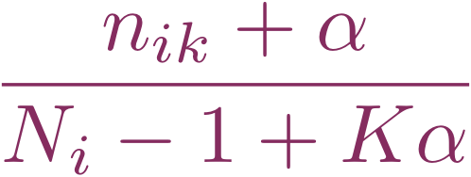




Probability of new assignment
3 | ? | 1 | 3 | 1
epilepsy | dynamic | Bayesian | EEG | model
Note: Though topic 2 count is zero the purple bar has some non zero width because that comes from the Bayesian prior
Topic 1
Topic 2
Topic 3
How much doc “likes” each topic based on other assignments in doc
# current assignments to topic k in doc i
 | Topic 1 | Topic 2 | Topic 3
Doc i | 2 | 0 | 2
smoothing parameter from Bayesian prior
# words in doc i

Slide 50







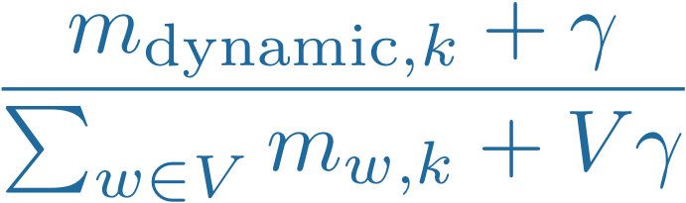

Probability of new assignment
3 | ? | 1 | 3 | 1
epilepsy | dynamic | Bayesian | EEG | model
Topic 1
Topic 2
Topic 3
How much each topic likes the word “dynamic” based on assignments in other docs in corpus
 | Topic 1 | Topic 2 | Topic 3
dynamic | 10 | 7 | 1
# assignments corpus-wide of word “dynamic” to topic k
smoothing parameter from Bayesian prior
Size of vocabulary

Slide 51


Probability of new assignment
3 | ? | 1 | 3 | 1
epilepsy | dynamic | Bayesian | EEG | model
Topic 1
Topic 2
Topic 3
 | Topic 1 | Topic 2 | Topic 3
dynamic | 10 | 7 | 1
Topic 2 also really likes “dynamic”, but in a diﬀerent context…
e.g., a topic on fluid dynamics

Slide 52
Probability of new assignment
3 | ? | 1 | 3 | 1
epilepsy | dynamic | Bayesian | EEG | model
Topic 1
Topic 2
Topic 3
Topic fits word
and document
Topic fits word, but not doc
Topic fits doc, but not word

Slide 53






Probability of new assignment
3 | ? | 1 | 3 | 1
epilepsy | dynamic | Bayesian | EEG | model
Topic 1
Topic 2
Topic 3
How much doc likes topic
How much topic likes word

Slide 54


Randomly draw a new topic indicator
3 | ? | 1 | 3 | 1
epilepsy | dynamic | Bayesian | EEG | model
Topic 1
Topic 2
Topic 3
To draw new topic assignment (equivalently):
- roll K-sided die with these probabilities
- throw dart at these regions
Normalize this product of terms over K possible topics
How much topic likes word
How much doc likes topic

Slide 55

Update counts
3 | 1 | 1 | 3 | 1
epilepsy | dynamic | Bayesian | EEG | model
 | Topic 1 | Topic 2 | Topic 3
Doc i | 2 | 0 | 2
 | Topic 1 | Topic 2 | Topic 3
epilepsy | 1 | 0 | 35
Bayesian | 50 | 0 | 1
model | 42 | 1 | 0
EEG | 0 | 0 | 20
dynamic | 10 | 7 | 1
...
Increment counts based on new assignment of Z_{iw} = 1

Slide 56




Geometrically…
3 | 1 | 1 | 3 | 1
epilepsy | dynamic | Bayesian | EEG | model
Topic 1
Topic 2
Topic 3
Increase popularity of “dynamic” in topic 1 (corpus-wide)
Increase popularity of topic 1 in doc i

Slide 57

Iterate through all words/docs
3 | 1 | 1 | 3 | 1
epilepsy | dynamic | Bayesian | EEG | model
 | Topic 1 | Topic 2 | Topic 3
Doc i | 2 | 0 | 2
 | Topic 1 | Topic 2 | Topic 3
epilepsy | 1 | 0 | 35
Bayesian | 50 | 0 | 1
model | 42 | 1 | 0
EEG | 0 | 0 | 20
dynamic | 10 | 7 | 1
...

Slide 58
What to do with the collapsed samples?
TOPIC 1
experiment 0.1
test 0.08
discover 0.05
hypothesize 0.03
climate 0.01
… …
TOPIC 2
develop 0.18
computer 0.09
processor 0.032
user 0.027
internet 0.02
… …
TOPIC 3
player 0.15
score 0.07
team 0.06
goal 0.03
injury 0.01
… …
…
Modeling the Complex Dynamics and Changing Correlations of Epileptic Events
0.6
0.4
0.2
0
Drausin F. Wulsinª, Emily B. Fox^{c}, Brian Litt^{a,b}
ªDepartment of Bioengineering, University of Pennsylvania, Philadelphia, PA ^{b}Department of Neurology, University of Pennsylvania, Philadelphia, PA ^{c}Department of Statistics, University of Washington, Seattle, WA
Abstract
Patients with
can manifest short, sub-clinical epileptic “bursts” in
epilepsy
 | clinical | seizures.
addition to full-blown We believe the relationship between these two classes of events—something not previously studied quantitatively— could yield important insights into the nature and intrinsic dynamics of seizures. A goal of our work is to parse these complex epileptic events into distinct dynamic regimes. A challenge posed by the intracranial EEG
(iEEG) data we study is the fact that the number and placement of electrodes
can vary between patients. We develop a
Bayesian | nonparametric | Markov
switching process that allows for (i) shared dynamic regimes between a vari-
able number of channels, (ii) asynchronous regime-switching, and (iii) an
The output of the collapsed Gibbs sampling is a list of topic indicators per word in each document
unknown dictionary of dynamic regimes. We encode a and changing
sparse
set of dependencies between the channels using a Markov-switching Gaussian
graphical model for the innovations process driving the channel dynamics and demonstrate the importance of this model in parsing and out-of-sample pre- dictions of iEEG data. produces intuitive state assignments that can help and enable
the comparison of sub-clinical bursts and full
Keywords: Bayesian nonparametric, EEG, factorial hidden Markov model, graphical model, time series
We show that our |  | model
automate | clinical | analysis of |  |  | seizures
 |  | clinical |  | seizures |  | .
One topic indicator z_{iw} per word in doc i
1. Introduction
Despite over three decades of research, we still have very little idea of
what defines a seizure. This ignorance stems both from the complexity of epilepsy as a disease and a paucity of quantitative tools that are flexible

Slide 59
What to do with the collapsed samples?
TOPIC 1
experiment | 0.1
test | 0.08
discover | 0.05
hypothesize | 0.03
climate | 0.01
… | …
Modeling the Complex Dynamics and Changing Correlations of Epileptic Events
0.6
0.4
0.2
0
Drausin F. Wulsinª, Emily B. Fox^{c}, Brian Litt^{a,b}
ªDepartment of Bioengineering, University of Pennsylvania, Philadelphia, PA ^{b}Department of Neurology, University of Pennsylvania, Philadelphia, PA ^{c}Department of Statistics, University of Washington, Seattle, WA
TOPIC 2
develop | 0.18
computer | 0.09
processor | 0.032
user | 0.027
internet | 0.02
… | …
Abstract
Patients with
can manifest short, sub-clinical epileptic “bursts” in
epilepsy
 | clinical | seizures.
addition to full-blown We believe the relationship between these two classes of events—something not previously studied quantitatively— could yield important insights into the nature and intrinsic dynamics of seizures. A goal of our work is to parse these complex epileptic events into distinct dynamic regimes. A challenge posed by the intracranial EEG
(iEEG) data we study is the fact that the number and placement of electrodes
From “best” sample of Z_{iw} we
can vary between patients. We develop a
Bayesian | nonparametric | Markov
switching process that allows for (i) shared dynamic regimes between a vari-
can infer:
able number of channels, (ii) asynchronous regime-switching, and (iii) an
unknown dictionary of dynamic regimes. We encode a and changing
sparse
set of dependencies between the channels using a Markov-switching Gaussian
1. Topics from conditional distribution (the topic vocabulary distribution)
need corpus-wide info
TOPIC 3
player | 0.15
score | 0.07
team | 0.06
goal | 0.03
injury | 0.01
… | …
graphical model for the innovations process driving the channel dynamics and
demonstrate the importance of this model in parsing and out-of-sample pre- dictions of iEEG data. produces intuitive state assignments that can help and enable
the comparison of sub-clinical bursts and full .
We show that our |  | model
automate | clinical | analysis of |  |  | seizures
 |  | clinical |  | seizures
Keywords: Bayesian nonparametric, EEG, factorial hidden Markov model, graphical model, time series
1. Introduction
…
Despite over three decades of research, we still have very little idea of
what defines a seizure. This ignorance stems both from the complexity of epilepsy as a disease and a paucity of quantitative tools that are flexible

Slide 60
What to do with the collapsed samples?
TOPIC 1
experiment 0.1
test 0.08
discover 0.05
hypothesize 0.03
climate 0.01
… …
TOPIC 2
develop 0.18
computer 0.09
processor 0.032
user 0.027
internet 0.02
… …
TOPIC 3
player 0.15
score 0.07
team 0.06
goal 0.03
injury 0.01
… …
…
Modeling the Complex Dynamics and Changing Correlations of Epileptic Events
0.6
0.4
0.2
0
Drausin F. Wulsinª, Emily B. Fox^{c}, Brian Litt^{a,b}
ªDepartment of Bioengineering, University of Pennsylvania, Philadelphia, PA ^{b}Department of Neurology, University of Pennsylvania, Philadelphia, PA ^{c}Department of Statistics, University of Washington, Seattle, WA
Abstract
Patients with
can manifest short, sub-clinical epileptic “bursts” in
epilepsy
 | clinical | seizures.
addition to full-blown We believe the relationship between these two classes of events—something not previously studied quantitatively— could yield important insights into the nature and intrinsic dynamics of seizures. A goal of our work is to parse these complex epileptic events into distinct dynamic regimes. A challenge posed by the intracranial EEG
(iEEG) data we study is the fact that the number and placement of electrodes
From “best” sample of Z_{iw}
we can infer:
can vary between patients. We develop a
Bayesian | nonparametric | Markov
switching process that allows for (i) shared dynamic regimes between a vari-
able number of channels, (ii) asynchronous regime-switching, and (iii) an
unknown dictionary of dynamic regimes. We encode a and changing
sparse
Document “embedding“ (forming the topic proportions for a given document)
need doc info only
set of dependencies between the channels using a Markov-switching Gaussian
graphical model for the innovations process driving the channel dynamics and
demonstrate the importance of this model in parsing and out-of-sample pre- dictions of iEEG data. produces intuitive state assignments that can help and enable
We show that our |  | model
automate | clinical | analysis of |  |  | seizures
 |  | clinical |  | seizures |  | .
the comparison of sub-clinical bursts and full
Keywords: Bayesian nonparametric, EEG, factorial hidden Markov model,
graphical model, time series
1. Introduction
Despite over three decades of research, we still have very little idea of
what defines a seizure. This ignorance stems both from the complexity of
epilepsy as a
disease and a paucity of quantitative tools that are flexible

Slide 61


Embedding new documents
TOPIC 1
experiment | 0.1
test | 0.08
discover | 0.05
hypothesize | 0.03
climate | 0.01
… | …
Modeling the Complex Dynamics and Changing Correlations of Epileptic Events
0.6
0.4
0.2
0
Drausin F. Wulsinª, Emily B. Fox^{c}, Brian Litt^{a,b}
ªDepartment of Bioengineering, University of Pennsylvania, Philadelphia, PA ^{b}Department of Neurology, University of Pennsylvania, Philadelphia, PA ^{c}Department of Statistics, University of Washington, Seattle, WA
TOPIC 2
develop | 0.18
computer | 0.09
processor | 0.032
user | 0.027
internet | 0.02
… | …
Abstract
Patients with
can manifest short, sub-clinical epileptic “bursts” in
epilepsy
 | clinical | seizures.
addition to full-blown We believe the relationship between these two classes of events—something not previously studied quantitatively— could yield important insights into the nature and intrinsic dynamics of seizures. A goal of our work is to parse these complex epileptic events
into distinct dynamic regimes. A challenge posed by the intracranial EEG
Simple approach:
Fix topics based on training set collapsed sampling
Run uncollapsed
sampler on new doc(s) only
(iEEG) data we study is the fact that the number and placement of electrodes
can vary between patients. We develop a
Bayesian | nonparametric | Markov
switching process that allows for (i) shared dynamic regimes between a vari-
able number of channels, (ii) asynchronous regime-switching, and (iii) an
unknown dictionary of dynamic regimes. We encode a and changing
sparse
set of dependencies between the channels using a Markov-switching Gaussian
TOPIC 3
player | 0.15
score | 0.07
team | 0.06
goal | 0.03
injury | 0.01
… | …
graphical model for the innovations process driving the channel dynamics and
demonstrate the importance of this model in parsing and out-of-sample pre- dictions of iEEG data. produces intuitive state assignments that can help and enable
We show that our |  | model
automate | clinical | analysis of |  |  | seizures
 |  | clinical |  | seizures |  | .
the comparison of sub-clinical bursts and full
Keywords: Bayesian nonparametric, EEG, factorial hidden
graphical model, time series
Markov
model,
1. Introduction
Despite over three decades of research, we still have very little idea of
…
what defines a seizure. This ignorance stems both from the complexity of
epilepsy as a
disease and a paucity of quantitative tools that are flexible

Slide 62
Practice / HW
Load the movie reviews data movie-pang02.csv from blackboard
Preprocess and clean the text by removing punctuations, stopwords etc.
Stem the text
Remove any other word that you see not relevant for topic modeling (e.g. will, their etc.)
Run a LDA topic model with Gibbs sampling and three topics
Extract the topic word probabilities and plot the top five most used words in each topic along with their betas.

